Slide 1
Content Authoring for Responsive Design
Mike Hamilton
V.P. Product Evangelism
MadCap Software
mhamilton@madcapsoftware.com

Slide 2
Agenda
Responsive Design
Core Components of Responsive Design
The Role of Content Structure
The Role of CSS
The Role of Media Queries
Responsive Design Strategies
Short Term RD Techniques
Long Term RD Plans
The RD Missing Link – Future of RD

Slide 3
What Is Responsive Design?

Slide 4
What Is Responsive Design?
A concept, first described by web designer Ethan Marcotte
http://alistapart.com/article/responsive-web-design
A design concept created to address “stress points”
Notes:
“stress points” are viewport sizes where even a traditional liquid or fluid design web site starts to fall apart and look terrible

Slide 5
What Is Responsive Design?
Responsive Design is NOT:
A smaller version of your page
Removing content to fit
A separate version for each and every device out there

Slide 6
What Is Responsive Design?
Responsive Design is:
A single version of your content
Delivered to your customer
In a way that is easily understood
No matter what device they are using

Slide 7
Core Components
of
Responsive Design

Slide 8
Core Components
Document Structure
CSS
Media Queries

Slide 9
Document
Structure

Slide 10
Document Structure
In Responsive Design less is more
Keep formatting out of the core document
EXAMPLE: No more hidden tables

Slide 11
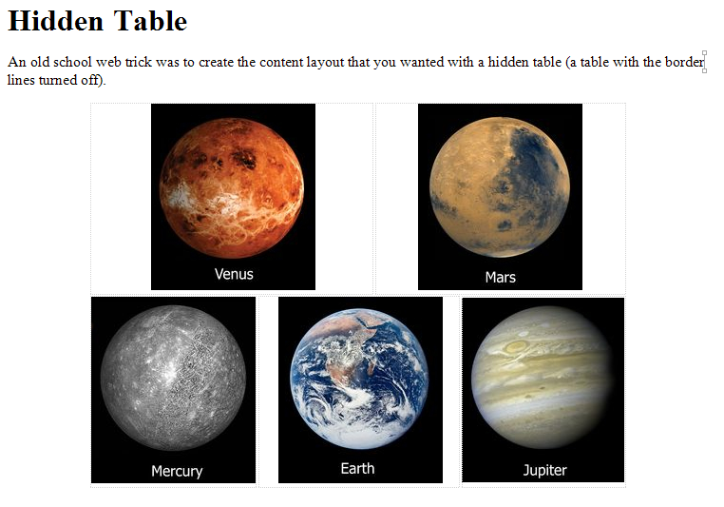
Document Structure

Slide 12
Document Structure

Slide 13
Document Structure
In addition to hidden layout tables, other items to avoid:
Fixed size DIV containers
Fixed size images
Any inline formatting/sizing
Notes:
Basically, sizing information no longer belongs in the document…period.

Slide 14
Document Structure
It may feel like going backward, but, the more your pages look like this…

Slide 15
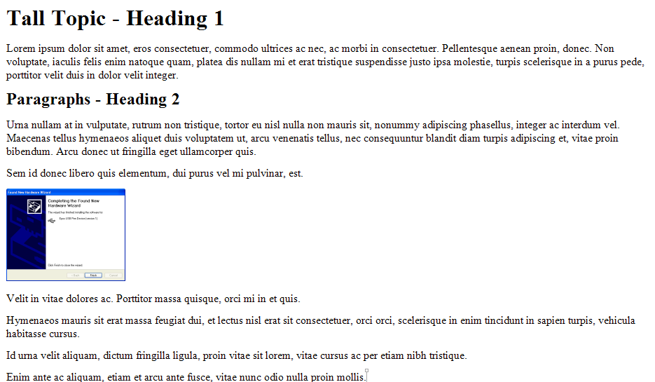
Document Structure
…the easier Responsive Design will be.
DEMO

Slide 16
CSS

Slide 17
CSS
The second leg of the RD stool is Cascading Style Sheets (CSS)
All look/feel/formatting
Block level (p, H1, H2, etc.)
Character level (span)
Grouping/formatting level

Slide 18
CSS

Slide 19
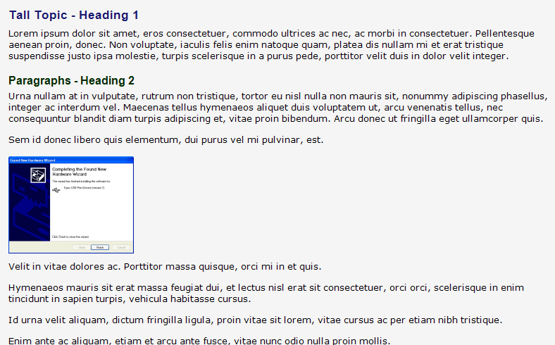
CSS

Slide 20
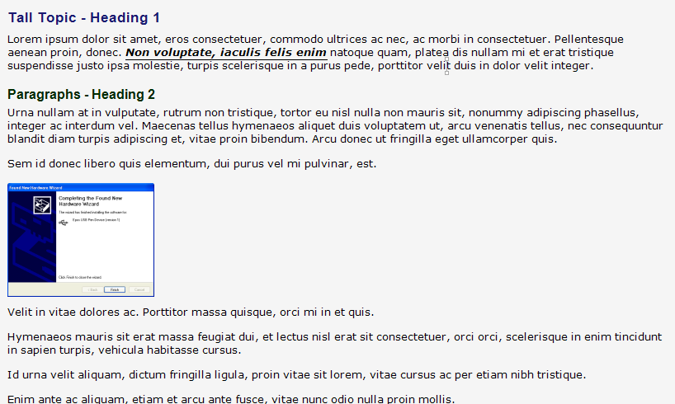
CSS

Slide 21
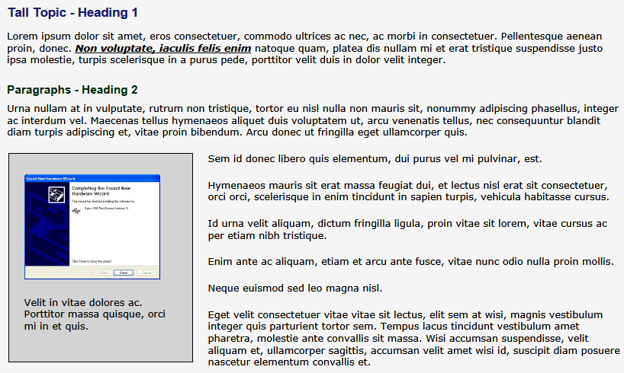
CSS

Slide 22
Font Sizing
Fixed Font Sizing
Fixed Font Sizing defines the size of fonts using absolute units such as points (pt), picas (pc), inches (in), centimeters (cm), etc.
Because of the differences in how various types of computers display content, Fixed Font Sizing will ALWAYS cause fonts to display smaller on some systems (like the Macintosh)
Notes:
Tips:
Various operating systems display fixed text sizes very differently. The 10 pt text that looks good on your desktop machine will require a magnifying glass to read on a Macintosh. This is due to differences in how operating systems render fixed size fonts. Fixed size fonts will always render differently on different platforms. This is due to different operating systems having different standards for the default points per inch (ppi).

Slide 23
Font Sizing
Relative Font Sizing
Relative units such as percentages (%), the em unit (em), numerical values (1-7), and descriptive values (xx-small - xx-large), etc.
Relative sizes refer to the font size of the parent element. This allows fonts to scale appropriately to different resolutions, browsers, or platforms

Slide 24
Font Sizing
Relative Font Size Guidelines
Define the size for the paragraph style as 100% to provide consistent looking, legible text on any platform
Define heading styles as a percentage of the normal text – e.g. Heading 1=120%, Heading 2=115%, etc.
Notes:
Defining the size info for the normal style as 100% will force the browser or display device to render normal text in the browsers default text size.
You can then define various heading sizes as a percentage of the normal text – e.g. 115%.
Since individual browsers are written to a particular operating systems, they already take the differing ppi standards into consideration.
Using the default browser text size (or a percentage of the default) should provide consistent looking, legible text on any platform.

Slide 25
Font Sizing
Relative Font Sizing - CAUTION
Watch out for the “fun-house mirror” factor that can occur when relative font sizes inherit from other relative font sizes
This can cause text to shrink or expand very quickly

Slide 26
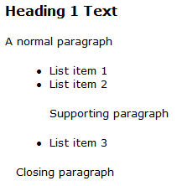
Fixed Font Sizing
body {font-size: 8pt;
font-family: Verdana, Arial,Helvetica, Sans-Serif;}
h1 {font-size: 12pt;}
div {margin-left: 10pt;
font-size: 10pt;}
li {font-size: 10pt;}
p {font-size: 10pt;}
<html >
<head>
<link href="test.css" rel="stylesheet" />
</head>
<body>
<h1>Heading 1 Text</h1>
<p>A normal paragraph</p>
<div>
<ul>
<li>List item 1</li>
<li>
<p>List item 2</p>
<p>Supporting paragraph</p>
</li>
<li>List item 3</li>
</ul>
<p>Closing paragraph</p>
</div>
</body></html>

Slide 27
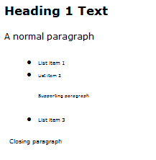
Relative Font Sizing
body {font-size: .8em;
font-family: Verdana, Arial,Helvetica, Sans-Serif;}
h1 {font-size: 1.2em;}
div {margin-left: 10pt;
font-size: .8em;}
li {font-size: .8em;}
p {font-size: .8em;}
<html >
<head>
<link href="test.css" rel="stylesheet" />
</head>
<body>
<h1>Heading 1 Text</h1>
<p>A normal paragraph</p>
<div>
<ul>
<li>List item 1</li>
<li>
<p>List item 2</p>
<p>Supporting paragraph</p>
</li>
<li>List item 3</li>
</ul>
<p>Closing paragraph</p>
</div>
</body></html>

Slide 28
Media
Queries

Slide 29
Media Queries
The new “Secret Sauce” of Responsive Design
Part of the CSS3 spec.
Derived from CSS2 Media Types

Slide 30
Media Types
@media screen
body
{
color: #000000;
font-family: Verdana, Arial, Helvetica, sans-serif;
font-size: 0.8em;
}
@media print
body
{
color: #000000;
font-family: “Times New Roman”;
font-size: 10pt;
}

Slide 31
Media Queries
Media Queries provide for:
Testing the parameters of the viewing device
Dynamically adjusting the CSS information based on the reported parameters

Slide 32
Media Types
@media screen and (max-width: 480px)
{
body
{
background-color: yellow;
}
}
@media screen and (min-width: 481px) and (max-width: 650px)
{
body
{
background-color: red;
}
}
@media screen and (min-width: 651px)
{
body
{
background-color: green;
}
}

Slide 33
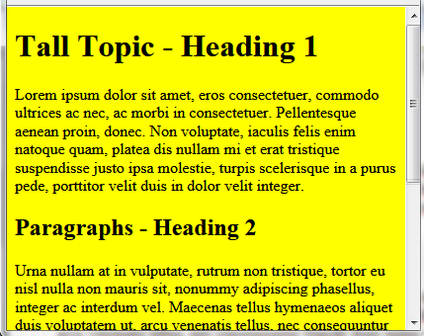
Media Types
@media screen and (max-width: 480px)
{
body
{
background-color: yellow;
}
}

Slide 34
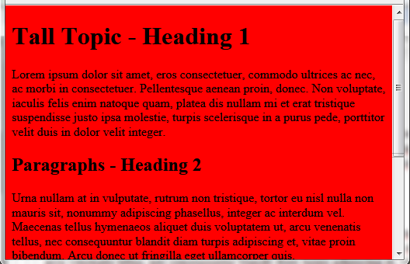
Media Types
@media screen and (min-width: 481px) and (max-width: 650px)
{
body
{
background-color: red;
}
}

Slide 35
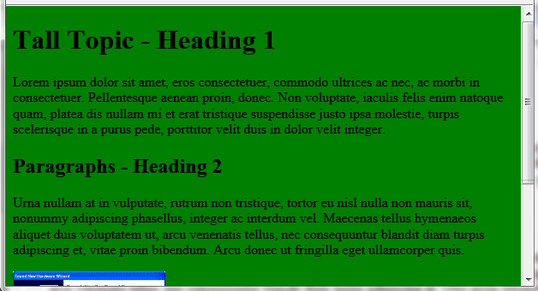
Media Types
@media screen and (min-width: 651px)
{
body
{
background-color: green;
}
}
DEMO

Slide 36
Media Queries
What can Media Queries test?
Width/Height (display area)
Width/Height (device)
Orientation(portrait/landscape)
Aspect Ratio
Resolution (pixel density)

Slide 37
Responsive
Design
Strategies

Slide 38
Strategies
First, focus on content areas and purposes, rather than specific formatting
Think of each of these areas as a grid element

Slide 39
Strategies
Header
Content
1
Content
2
Content
3

Slide 40
Strategies
Header
Content
1
Content
2
Content
3

Slide 41
Strategies
Header
Content 1
Content 2
Content 3

Slide 42
Strategies
To control your grid elements the concept of “break-points” was developed
Break-points are the media query value where you want your grid to change

Slide 43
Strategies
There are differing break-point strategies
One school is to create break-points based on the resolution of common devices
…except

Slide 44
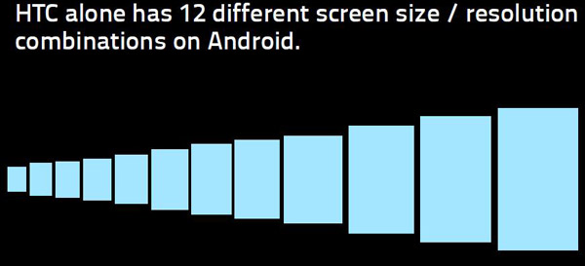
Common Device Resolutions
HTC is just one phone vendor
Android is just one type of HTC phone

Slide 45
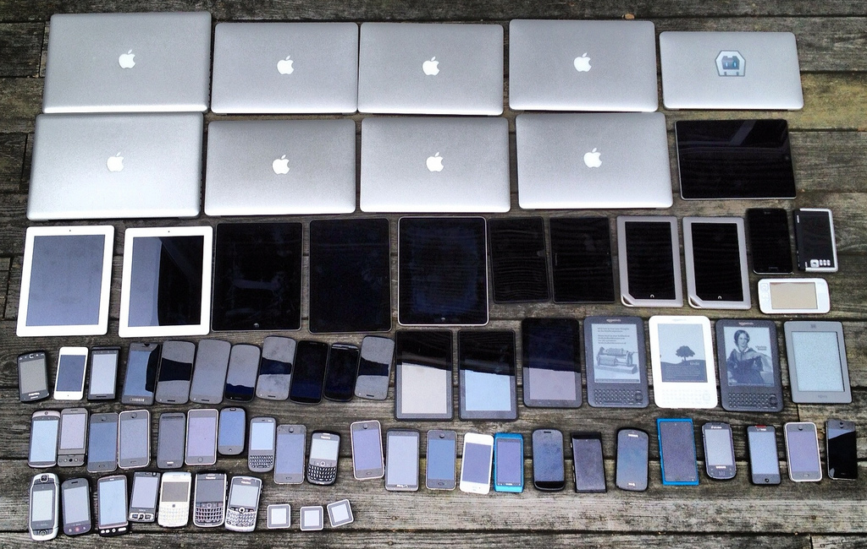
Common Device Resolutions

Slide 46
Common Device Resolutions
Resolution / Graphic Array
2880 x 1800
2560 x 1700
2560 x 1600 WQXGA
2560 x 1440 (W)QHD
2048 x 1536 QXGA
1920 x 1280
1920 x 1200 WUXGA
1920 x 1080 FHD
1680 x 1050 WSXGA+
1600 x 1200 UXGA
Resolution / Graphic Array
1600 x 900 HD+
1440 x 900 WXGA+
1366 x 768 WXGA
1280 x 1024 SXGA
1280 x 800 WXGA
1280 x 768 WXGA
1280 x 720 HD / WXGA
1024 x 768 XGA
1024 x 600 WSVGA
Resolution / Graphic Array
1136 x 640
960 x 640 DVGA
960 x 540 qHD
854 x 480 FWVGA
800 x 480 WVGA
720 x 720
640 x 480 VGA
640 x 360 nHD
480 x 360
480 x 320 HVGA
Resolution / Graphic Array
400 x 240 WQVGA
320 x 240 QVGA
Over 31 different device resolutions in use
DEMO

Slide 47
Strategies
An easier break-point strategy:
Determine the min/max width values you must support
Resize your browser and watch for where your content breaks
DEMO

Slide 48
Strategies
Break the large image into smaller images
Add CSS class data as necessary
<p class="venus">
<img src="../Resources/Images/venus.png" class="venus" />
</p>
DEMO

Slide 49
Strategies
Now create the Media Queries
@media screen and (max-width: 450px){
body { background-color: yellow; }
p.mercury { text-align: center; }
p.venus { text-align: center; }
p.earth { text-align: center; }
p.mars { text-align: center; }
p.jupiter { text-align: center; }
}
DEMO

Slide 50
Strategies
Now create the Media Queries
@media screen and (min-width: 451px) and (max-width: 910px)
{
body { background-color: red; }
p.mercury { text-align: center; }
img.mercury { }
img.venus { float: left; }
img.earth { float: right; }
img.mars { float: left; clear: both;}
img.jupiter { float: right; }
}
DEMO

Slide 51
Strategies
Now create the Media Queries
@media screen and (min-width: 911px)
{
body { background-color: green; }
img.mercury { float: left; }
img.venus { float: left; }
img.earth { float: left; }
img.mars { float: left; }
img.jupiter { float: left; }
}
DEMO

Slide 52
Short Term
Technique
While Striving for RD

Slide 53
Short Term Techniques
Brush up on CSS skills
The DIV element is your friend
The quickest / dirtiest short term workaround
div.rdoverflow

Slide 54
Short Term Techniques
Add to your style sheet:
div.rdoverflow
{
overflow: auto;
}

Slide 55
Short Term Techniques
Wrap any content that doesn’t fit on a target screen (such as a large table) with:
div.rdoverflow
Scroll bars will be added automatically when needed
DEMO

Slide 56
Long Term
Responsive Design
Recomendations

Slide 57
Long Term Recommendations
Study
Practice

Slide 58
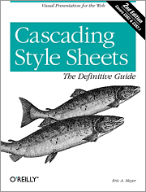
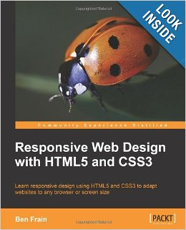
Suggested Reading List
Cascading Style Sheets: Designing for the Web (3rd Edition) (Paperback) by Hakon Wium Lie and Bert Bos
ISBN-13: 978-0321193124
CSS: The Definitive Guide, Third Edition
by Eric Meyer
ISBN-13: 978-0596527334
Responsive Web Design with HTML5 and CSS3
by Ben Frain
ISBN-13: 978-9350237885

Slide 59
A Final Word
The Missing Piece In
Responsive Design

Slide 60
The Missing Piece
Media Queries are great for getting size information
There is currently no reliable way to determine the interface type
High resolution pointing device
Low resolution pointing device

Slide 61
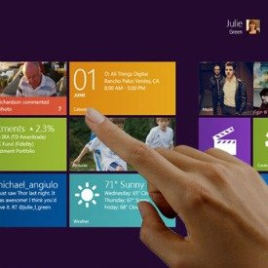
The Missing Piece
High Resolution Pointing Device
Low Resolution Pointing Device

Slide 62
Summary
Responsive Design
Core Components of Responsive Design
The Role of Content Structure
The Role of CSS
The Role of Media Queries
Responsive Design Strategies
Short Term RD Techniques
Long Term RD Plans
The RD Missing Link – Future of RD

Slide 63
Questions?
Mike Hamilton
V.P. Product Evangelism
MadCap Software
mhamilton@madcapsoftware.com

Slide 64
Thank you
Mike Hamilton
V.P. Product Evangelism
MadCap Software
mhamilton@madcapsoftware.com

