Slide 1
Google Analytics In and Out of the Box
Mark Ginsberg
Megacomm 2014

Slide 2
It’s Free!
Flickr

Slide 3
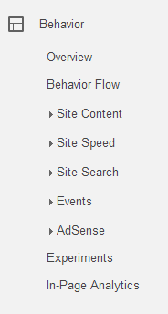
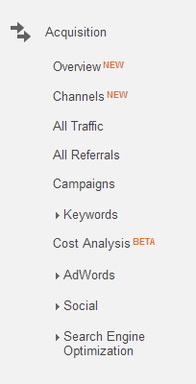
It’s Feature Packed!

Slide 4
But Also Confusing and Daunting
Flickr

Slide 5
Key To Analytics
Look at metrics that matter
Don’t report on metrics for the sake of metrics – get to business intelligence and understand the story behind the data
Get actionable takeawaysfrom the data

Slide 6
The Rise of Not Provided
Image Courtesy of mikearnesen.com

Slide 7
The Olden Days – Jan 2012

Slide 8
It’s Just Gonna Get Higher

Slide 9
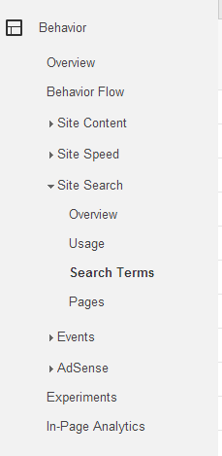
Site Search to the Rescue

Slide 10
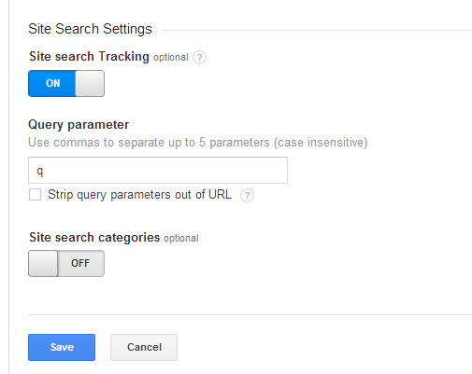
Configuration – know your URL
Admin > Account > Property > View
> View Settings

Slide 11
Hidden in the Data

Slide 12
Segmentation – Data Awesomeness
Bonus hint – tag your links / campaigns

Slide 13
Advanced Segments FTW!

Slide 14
Custom Reports

Slide 15
Google Analytics Solutions Gallery

Slide 16
Premade Templates Rock!

Slide 17
Custom Report for Import - Content Efficiency Analysis

Slide 18
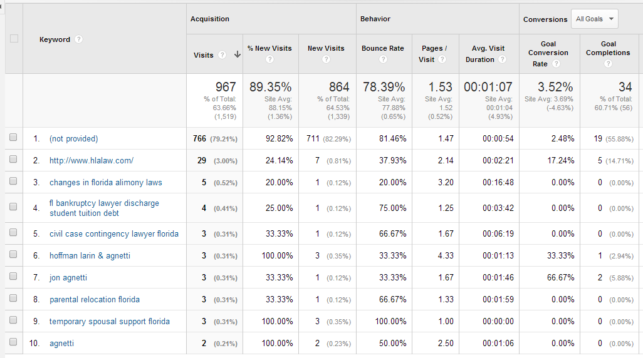
Adding Secondary Dimensions to Standard Reports
80% Not Provided

Slide 19
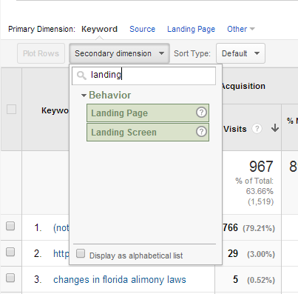
Secondary Dimensions – Break it down!

Slide 20
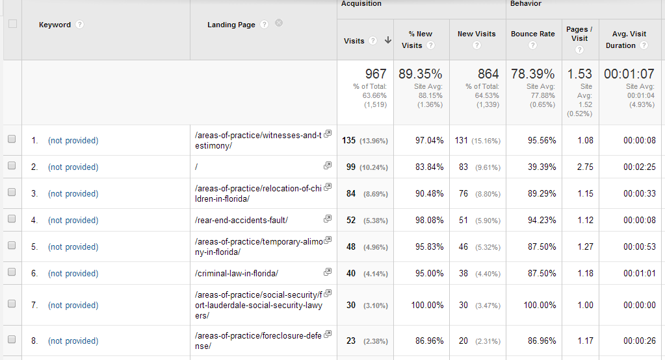
Landing Page as a Secondary Dimension for KW (not provided)

Slide 21
Takeaways
Actionable data is key
Dig Deeper
Segment for Success
Set up Site Search
Use Custom Reports and Advanced Segments
Secondary Dimensions Are Awesome

Slide 22
Stay in Touch – Happy to help
Mark Ginsberg
Founder of DriveHill Media
Marketing Director – Beyond Stores
mark@drivehillmedia.com
@msginsberg
Skype – msginsberg

